Slide 1
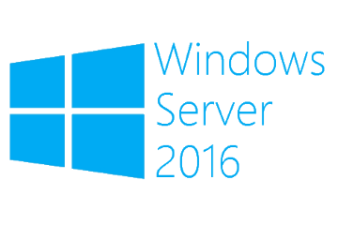
Powershell Direct and VM Offline File Copy
Megaseries

Slide 2
Powershell Direct
Run Powershell commands on VMs located on the host from which the commands are run without needing a network adapter (uses the VMBus)
Use a local account or a domain account that has a user profile on the VM
Behaves exactly like Powershell Remoting and uses the same commands

Slide 3
Offline File Copy
Copy files (not working with folders) from the host to locally hosted VMs
Does not need authentication but requires the machine to have the Guest Services integration service enabled
Does not work from guest to host

Slide 4
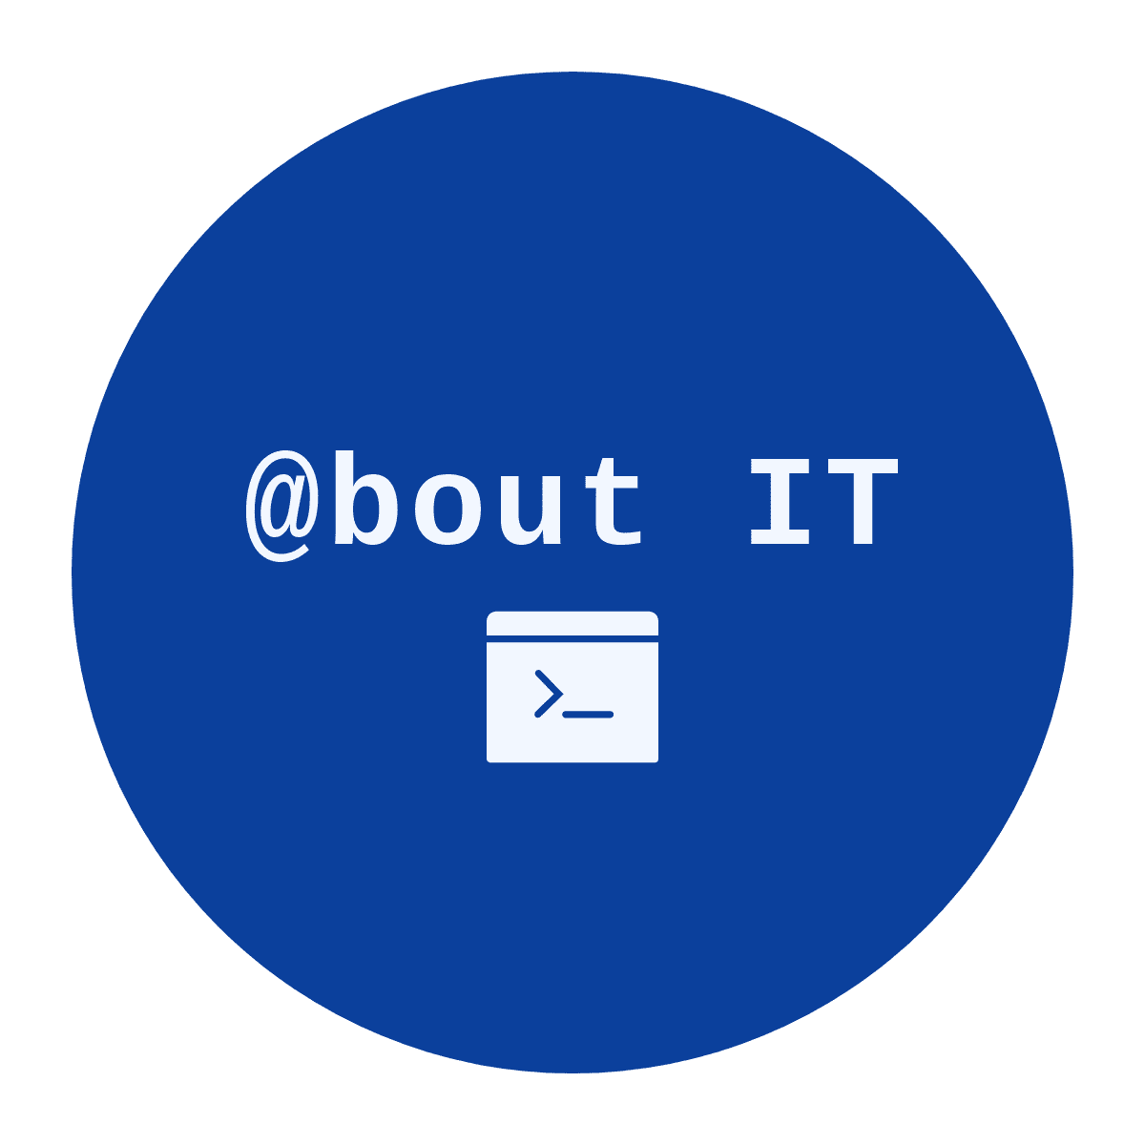
https://www.youtube.com/channel/UCcZ-jLbPwNr8E_v9-65n8Iw https://github.com/itknowledge4

